Slide 1
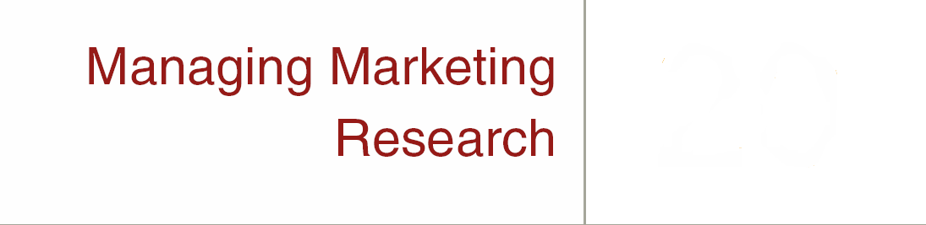

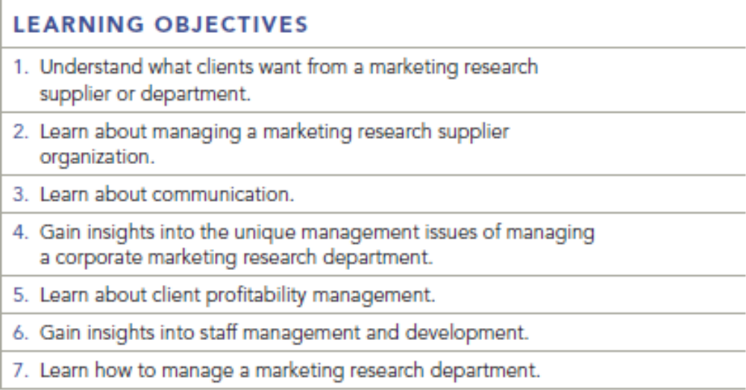
Chapter Twenty
20-1

Slide 2

Marketing Research Supplier Management
What Clients Want – A Researcher Who:
1. Maintains client confidentiality
2. Is honest
3. Is punctual
4. Is flexible
5. Delivers against project specifications
6. Provides high-quality output
7. Is responsive to the client’s needs
8. Has high quality-control standards
9. Is customer-oriented in interactions with client
10. Keeps the client informed throughout a project
20-2
Key Terms & Definitions

Slide 3
Managing the Research Process
Research Management:
Overseeing the development of excellent communication systems, data quality, time schedules, cost controls, client profitability, and staff development.
20-3
Key Terms & Definitions

Slide 4

Managing the Research Process
Some Key Issues:
Organizing the Supplier Firm
Data Quality Management
Time Management
Cost Management
Outsourcing
20-4
Key Terms & Definitions

Slide 5
Outsourcing
Outsourcing:
Having personnel in another country perform some or all of the functions involved in a marketing research project.
Captive Outsourcing:
When a research firm creates a wholly-owned foreign facility for outsourcing.
20-5
Key Terms & Definitions

Slide 6
Outsourcing Issues
Confidentiality
Infrastructure
Quality of deliverables
Domain knowledge
Cultural issues
Job losses in the client country and associated negative publicity for the agency
Employee liability
20-6
Key Terms & Definitions

Slide 7
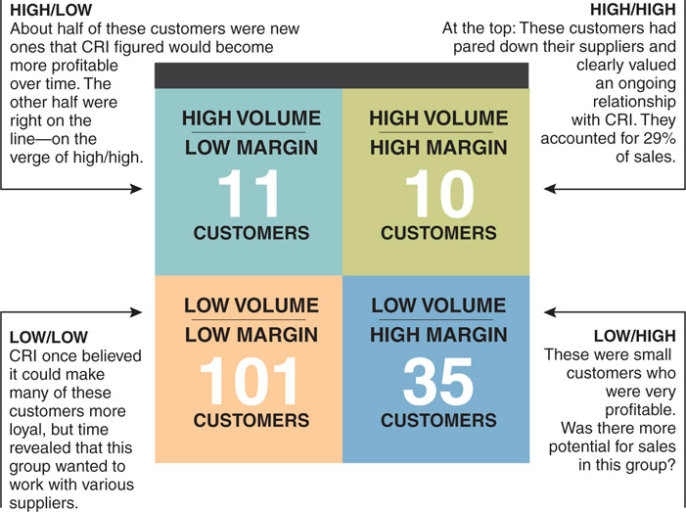
Client Profitability Analysis
20-7
Key Terms & Definitions

Slide 8
Screening Questions Used by CRI
How did you hear about us?
What king of work is it (in terms of industry scope)?
What’s your budget?
What are your decision criteria?
Whom are we competing against for your business?
Why are you thinking of switching?
20-8
Key Terms & Definitions

Slide 9
Staff Management and Development
Some Key Techniques:
Create an environment that encourages risk taking, experimentation, and responsibility.
Foster recognition and accountability.
Provide job autonomy within a certain structure.
Attract and support people with entrepreneurial attitudes.
Connect rewards to a business result.
Open your financial books.
Offer diversity within your organization.
Provide clear promotional paths.
20-9
Key Terms & Definitions

Slide 10
Managing a Marketing Research Department
Critical Issues:
Allocating the research department budget.
Prioritizing projects.
Retaining skilled staff.
Selecting the right marketing research suppliers.
Moving marketing research into a decision-making role.
20-10
Key Terms & Definitions

Slide 11
Retaining A Skilled Staff
Conduct regular performance reviews that give continuing feedback on a job well done—or offer ways to improve.
Offer public recognition for great work. Some examples are in the text.
Give differential pay raises that recognize superior performance.
Vary the work in order to keep everyone interested.
20-11
Key Terms & Definitions

Slide 12
Selecting the Right Marketing Research Suppliers
Key Questions:
How long has the vendor been in business?
For what other companies has the vendor conducted research projects?
What are the academic backgrounds and experience of those persons who will be working on the projects, that is, the project director, field director, data processing manager, and so forth?
Does the composition of the project team strike the right balance between top-level management and technical researchers and analysts?
Does the success of the project depend on the capabilities of a subcontractor?
20-12
Key Terms & Definitions

Slide 13

Soft Skills of the Ideal Marketing Researcher
Lifelong Learners
Adapt Easily
Act as a Partner
20-13
Key Terms & Definitions
Notes:
These are called soft skills of marketing researchers. These points are discussed in more detail in the “Practicing Marketing Research” box in the text.

Slide 14
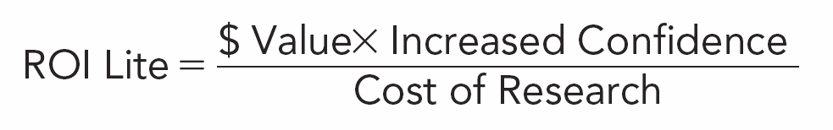
Two Approaches to Measuring ROI
ROI Lite
ROI Complete
20-14
Key Terms & Definitions
Notes:
Refer to the text for quantitative examples using these formulas.

Slide 15
Key Terms & Definitions
Research Management
Outsourcing
Captive Outsourcing
Outsourcing Issues
What Clients Want
Client Profitability Management
Sample Client Screening Questions
Managing Difficult Clients
Staff Management and Development
Managing a Marketing Research Department
Retaining a Good Staff
Selecting the Right Marketing Research Supplier
Maintaining a Competitive Advantage
Measuring Return on Investment (ROI)
ROI Example
Links and button are active when in “Slide Show Mode”
Key Terms & Definitions
20-15

